Slide 1


PORTFOLIO THEME BUILDER
Supervised By:
Ms. Baljeet Kaur
Mr. Vikas Patel
Submitted By:
Kanishk Kharbanda (2210990472)
Lokesh Garg (220990544)
Kapish Aggarwal (2210990476)
Jaspreet Sandhu (2210990453)

Slide 2

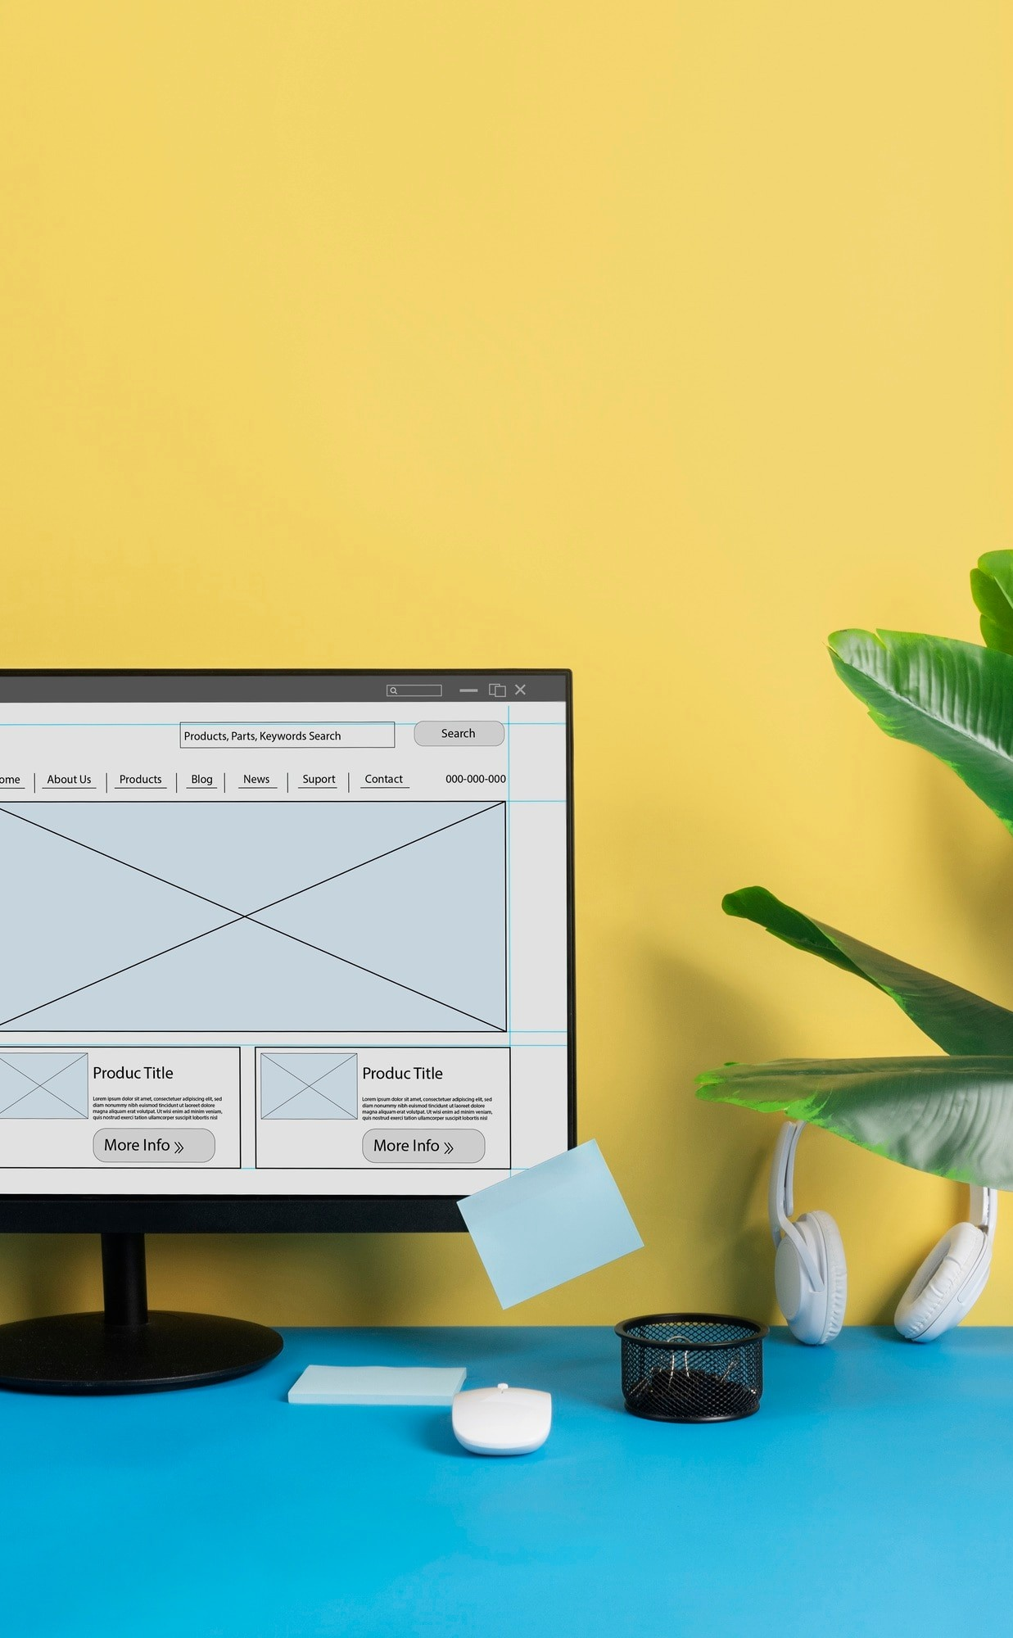
INTRODUCTION
Introducing our Portfolio Theme Builder: the ultimate solution for crafting personalized portfolios effortlessly. Simply fill out a brief form, and watch as your unique professional identity comes to life. Say hello to seamless design and goodbye to generic templates. Welcome to a new era of portfolio creation.

Slide 3

PROBLEM STATEMENT
In today's digital era, individuals encounter numerous challenges when it comes to creating and managing their online presence through portfolios. These challenges include:
Lack of customization
Technical complexity
Compatibility issues
Inefficient design workflow

Slide 4
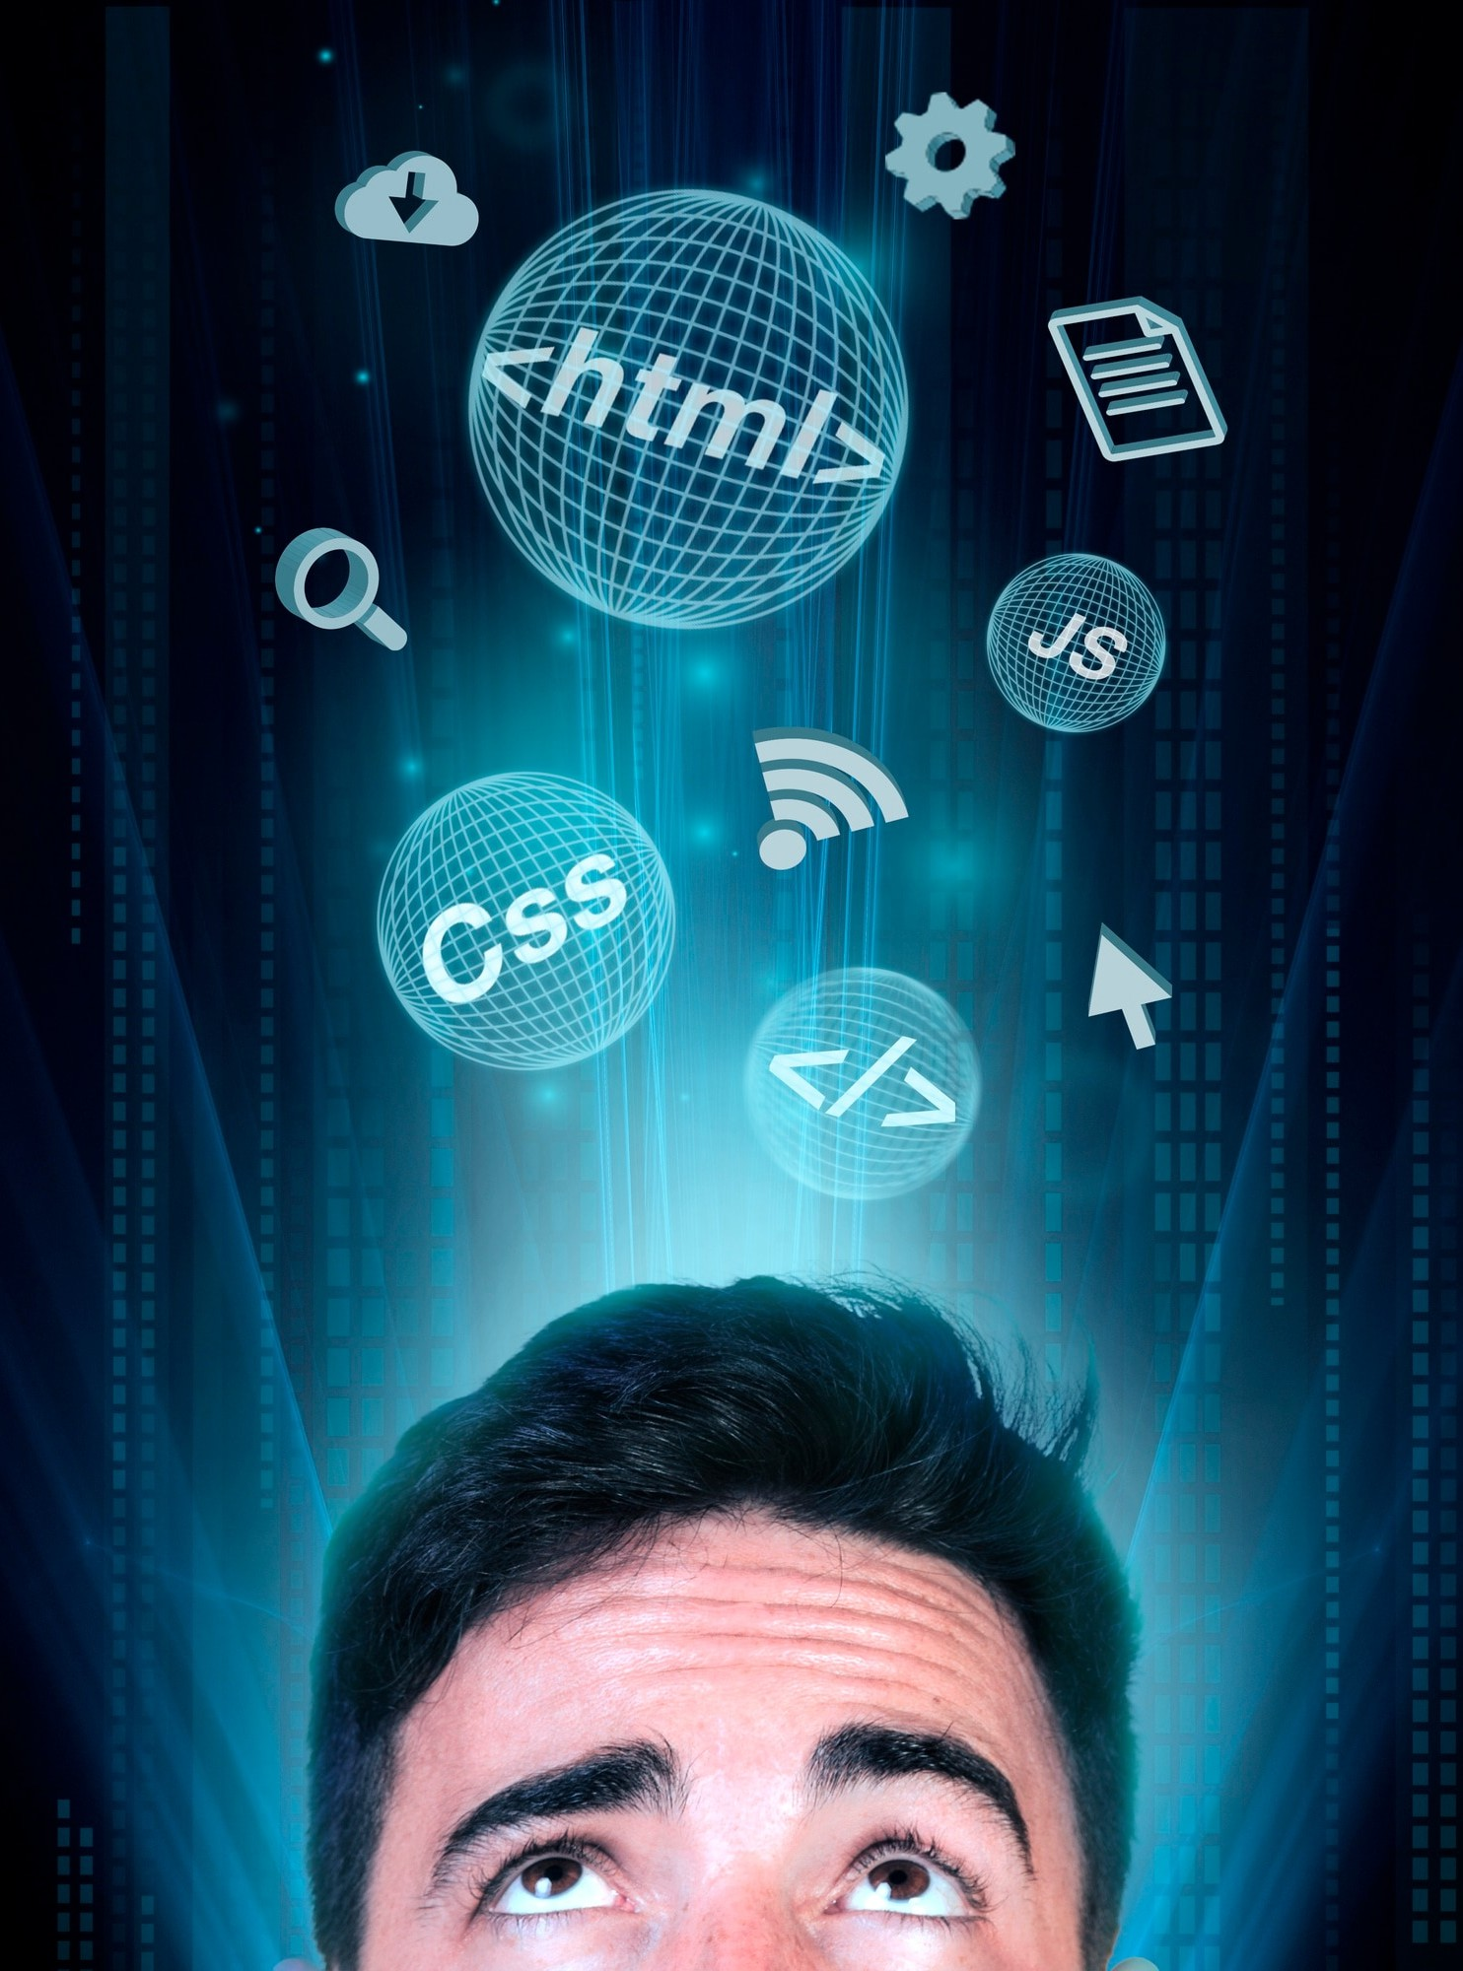
TECH STACK USED
HTML, CSS, and JavaScript form the sturdy foundation, while React and Next.js bring dynamic functionality to the forefront. With the added flair of Shadcn UI, our Portfolio Theme Builder ensures a seamless user experience and visually stunning results.

Slide 5
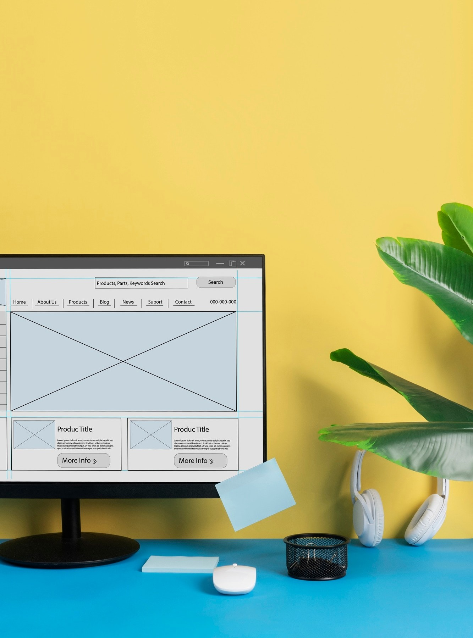
HTML, CSS AND JAVASCRIPT
HTML: Used for structuring the web page.
CSS: Used for Styling the web page.
JAVASCRIPT: For adding the user interactivity.

Slide 6
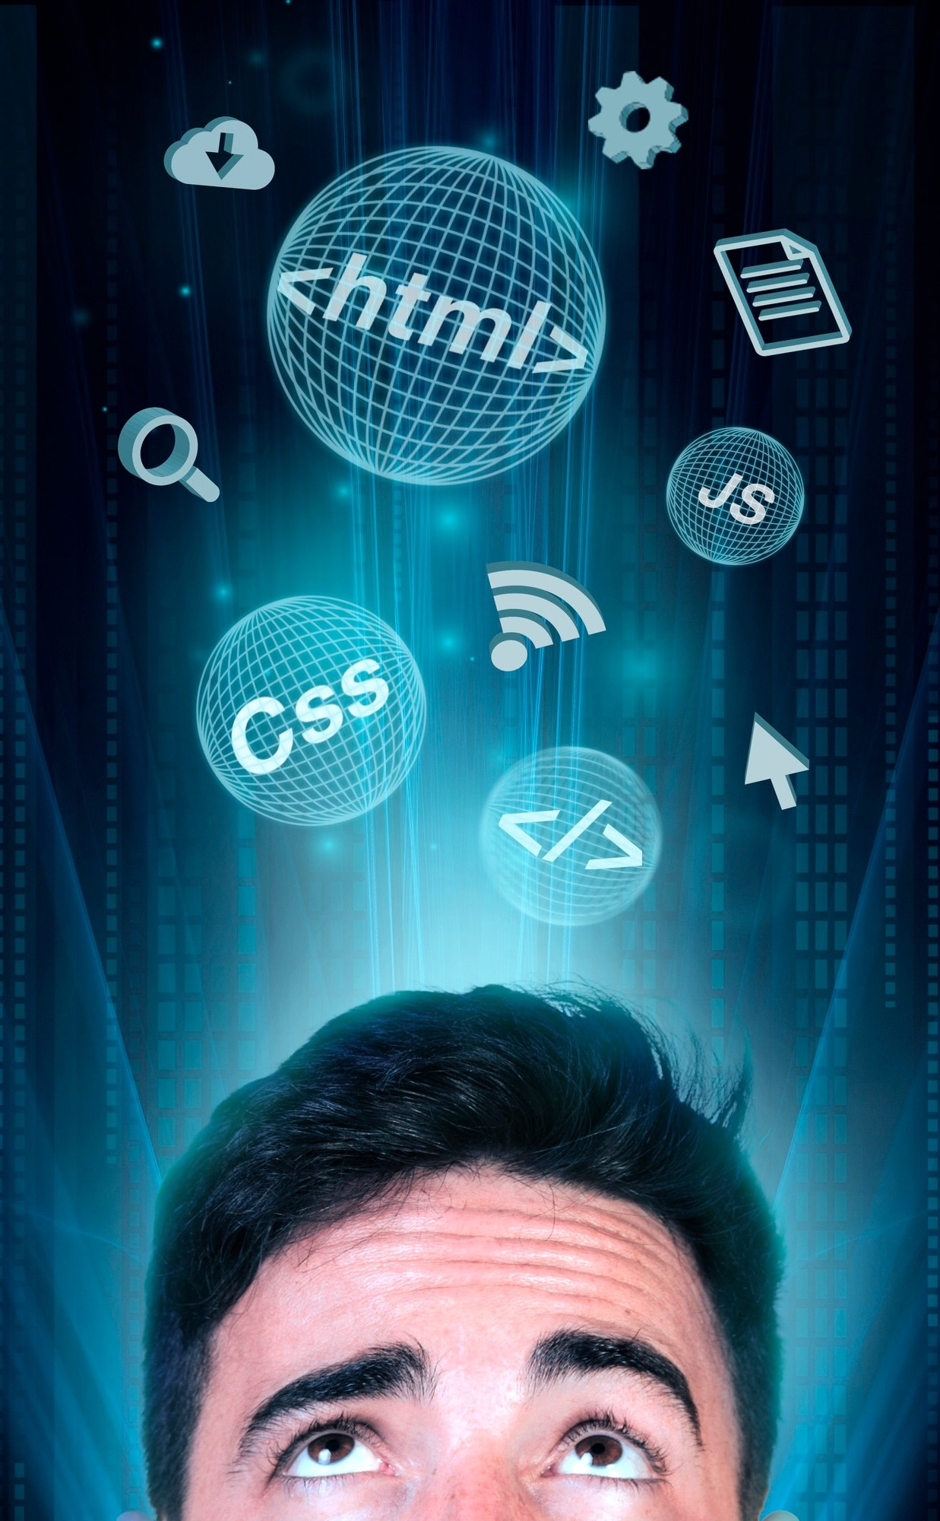
REACT, NEXT.JS
REACT is used for building dynamic user interface as it simplifies development, encourages code reusability, and enhances the performance.
NEXT.JS is used for server side rendering, routing and enhanced performance.

Slide 7

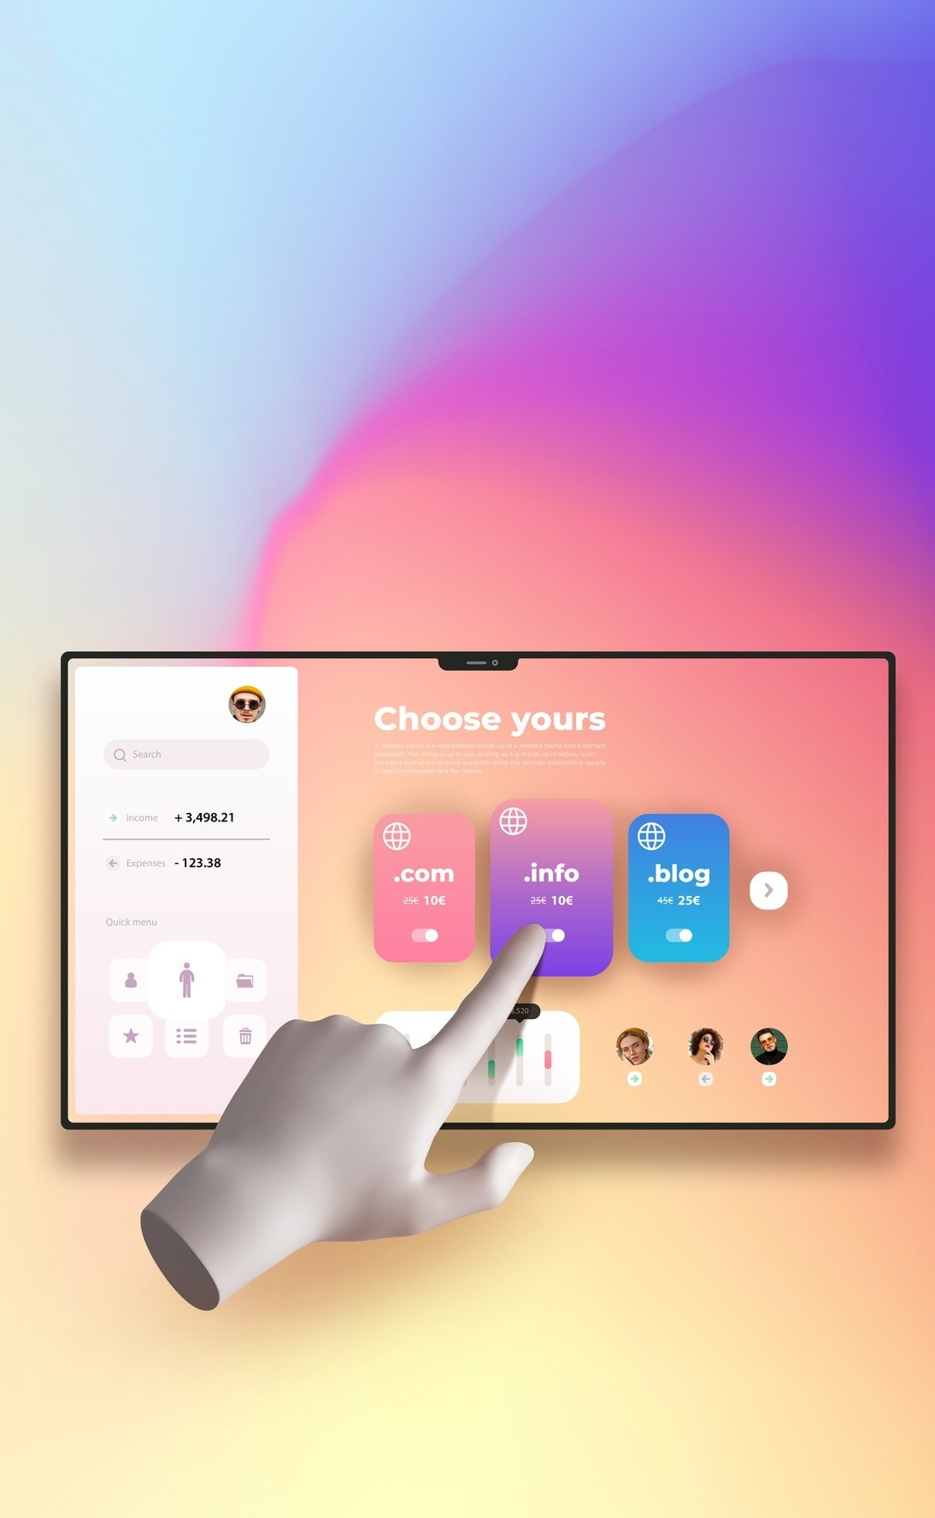
Shadcn UI Integration
Shadcn UI is used to elevate the user experience. It offers a rich library of pre-designed components, styles, and themes that enhance the visual presentation of our Portfolio Theme Builder.
We ensure consistency, accessibility and modern design standards across our platform, resulting in a proper user interface that resonates with the audience.

Slide 8
SIGNIFICANCE
This project addresses a critical need in the professional world by simplifying the process of creating personalized portfolios.
Additionally, it democratizes access to quality design and technology, enabling users of all backgrounds to craft impressive online identities. Ultimately, this project embodies our commitment to innovation, empowerment, and inclusivity in the digital landscape.

Slide 9
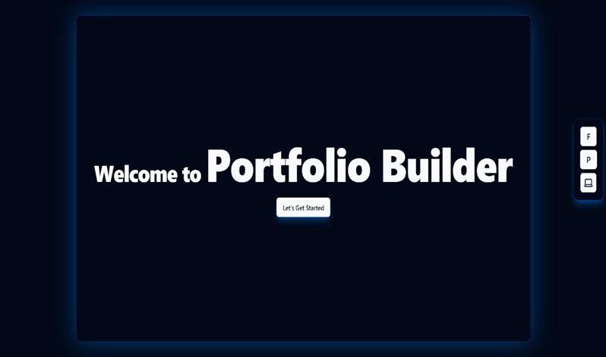
SOME SNAPSHOTS
This is the front page !

Slide 10
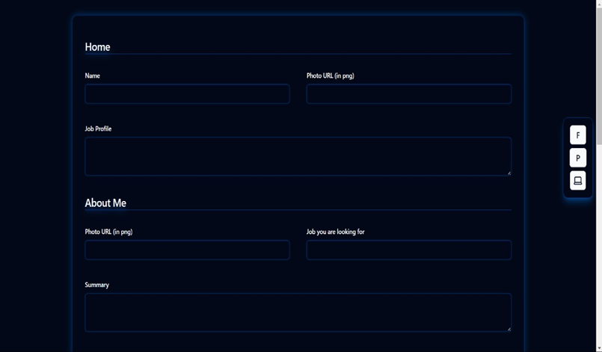
SOME SNAPSHOTS (cont..)
This is the form where the user inputs data !

Slide 11
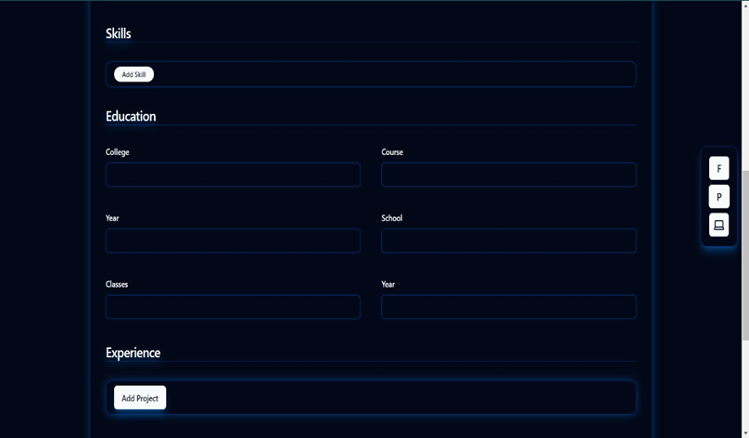
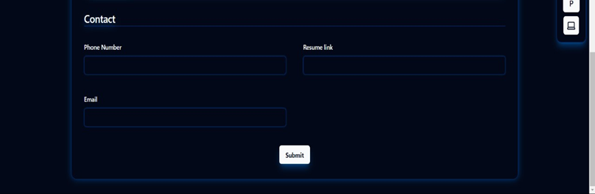
SOME SNAPSHOTS (cont..)
This is the form where the user inputs data !

Slide 12
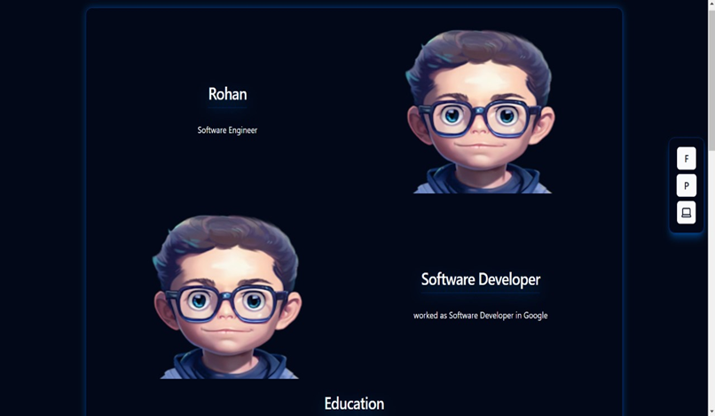
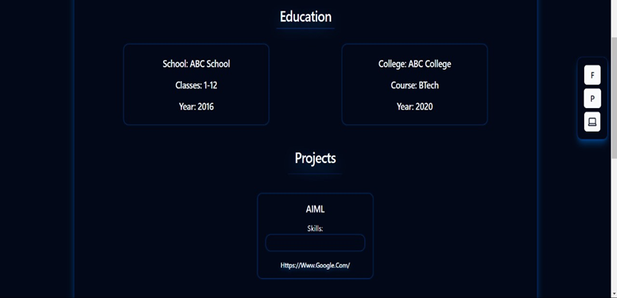
SOME SNAPSHOTS (cont..)
And this is the portfolio!

Slide 13
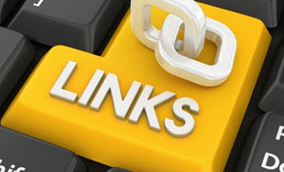
LINKS AND REFS. USED
GeeksForGeeks
W3 Schools
Codepen.com
react.org
Devdocs.io
Freecodecamp.org
MDN web-docs

Slide 14


Thanks!

